Slide 1
The Future of Free Expression Online
Nick Feamster Princeton University

Slide 2
Control of Online Speech
Who gets to speak? Filtering and manipulation of Internet protocols
HTTP, TCP/IP, DNS
Circumvention tools (e.g., Tor)

Slide 3
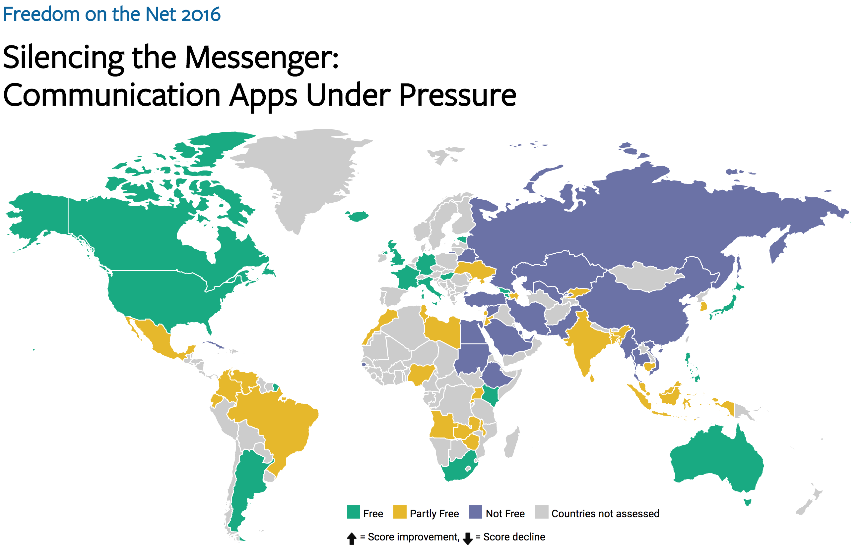

Slide 4





Conventional: Measurement with People
Anecdote
(Twitter censored in Iran)
Researcher
Custom measurement software
Vantage points
Censor
Web service
Notes:
The biggest drawback is scale
Still effectively anecdotes
Political and social scientists want more data
The Citizen Lab, Berkman Center, Princeton, etc.

Slide 5
Our Work: Large-Scale Measurement
Origin Web site
GET /
Vantage point
“Can you access http://twitter.com?”
http://encoreenco.re
Web browser
in Iran
Cross-origin
GET /favicon.ico
Measurement target
How?
Censor
http://twitter.com
Burnett, Sam, and Nick Feamster. "Encore: Lightweight measurement of web censorship with cross-origin requests." ACM SIGCOMM. 2015

Slide 6
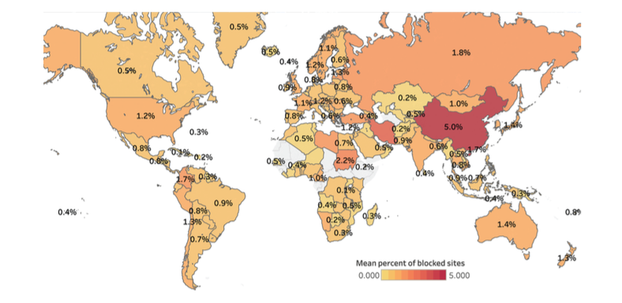
Pearce, Paul, et al. "Augur: Internet-Wide Detection of Connectivity Disruptions." Security and Privacy (SP), 2017 IEEE Symposium on. IEEE, 2017.
Notes:
Global heat map showing the percentage of sites filtered for any client in countries around the world. China experiences the highest average amount of filtering, at 5% of measurable sites filtered by a resolver within the country.

Slide 7
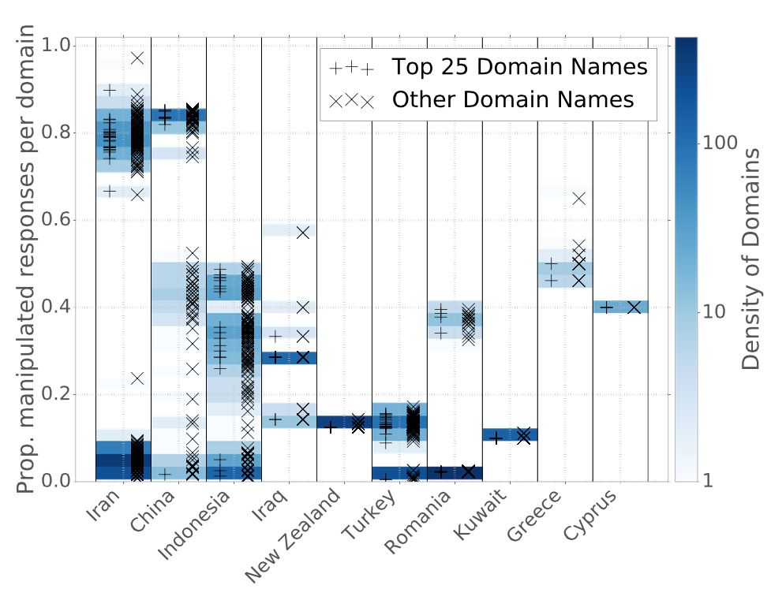
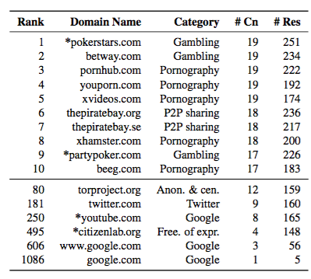
Manipulation of Websites within Countries
Notes:
----- Meeting Notes (4/14/17 13:50) -----
Need a version of this plot by category.

Slide 8
Control of Online Speech
Who gets to speak? Filtering and manipulation of Internet protocols
HTTP, TCP/IP, DNS
Circumvention tools (e.g., Tor)
Who can be heard? Filtering and manipulation on Internet platforms
Filter bubbles, Personalization (and attacks)
Propaganda and bots
Automated filtering

Slide 9
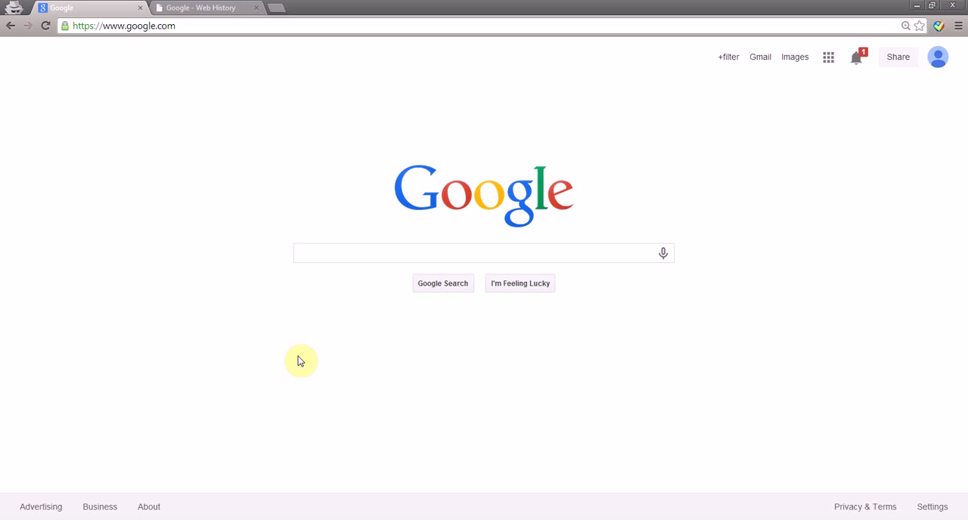
Attack: Manipulate Personalization
Take This Personally: Pollution Attacks on Personalized Services. X. Xing, W. Ming, D. Doozan, A. Snoeren, N. Feamster, W. Lee. In USENIX Security Symposium, 2013.

Slide 10
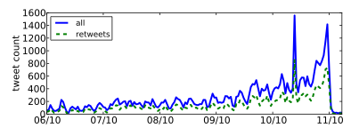
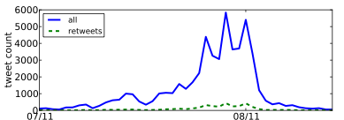
Attack: Spread “Propaganda”
Nevada Senate Race
Higher fraction of retweets
More bursty tweeting volumes
Higher daily volumes
Quick retweeting
Debt Ceiling Debate
#bias: Measuring the Tweeting Behavior of Propagandists
by Cristian Lumezanu, Nick Feamster, and Hans Klein.
In the Sixth International AAAI Conference on Weblogs and Social Media (ICWSM), 2012.
Notes:
Note: This study likely no longer works.

Slide 11
Control of Online Speech
Who gets to speak? Filtering and manipulation of Internet protocols
HTTP, TCP/IP, DNS
Circumvention tools (e.g., Tor)
Who can be heard? Filtering and manipulation on Internet platforms
Filter bubbles, Personalization (and attacks)
Propaganda and bots
Automated filtering

Slide 12
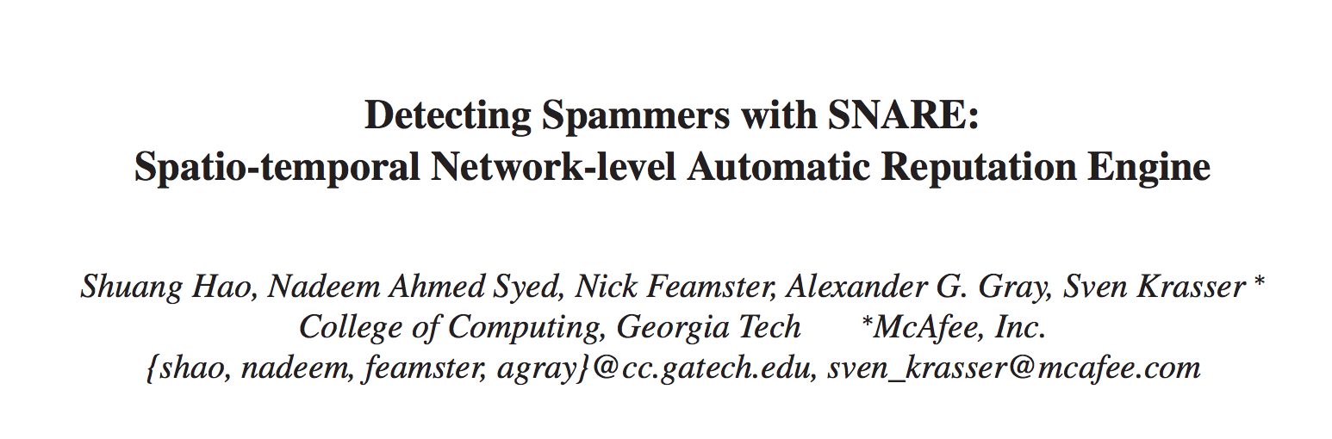
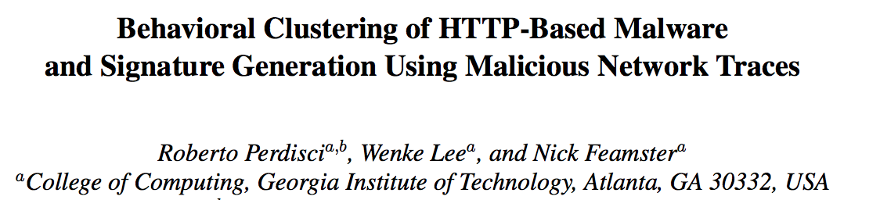
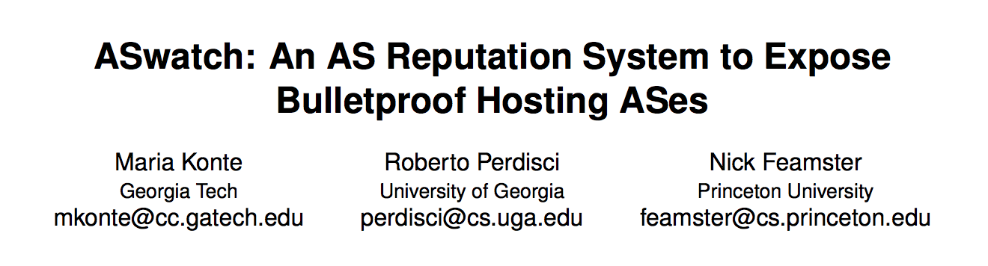
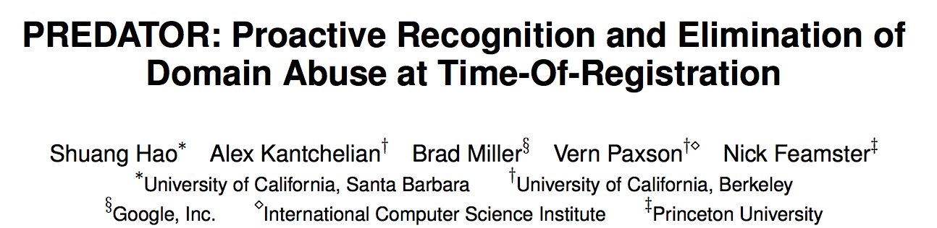
Filtering “Unwanted Content”
Email Spam (2009)
Web-based Malware (2010)
Bulletproof Web Hosting (2015)
Early Detection of DNS Abuse (2016)

Slide 13
Filtering “unwanted content” is nothing but goodness, right…?

Slide 14
...depends on who gets to decide what is “wanted”.

Slide 15


Slide 16
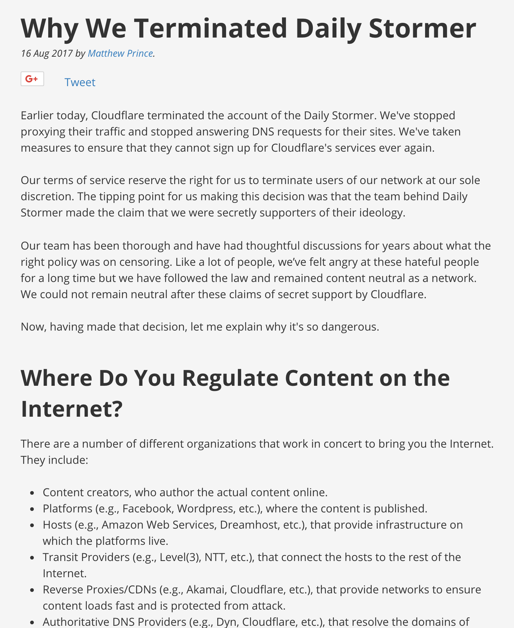

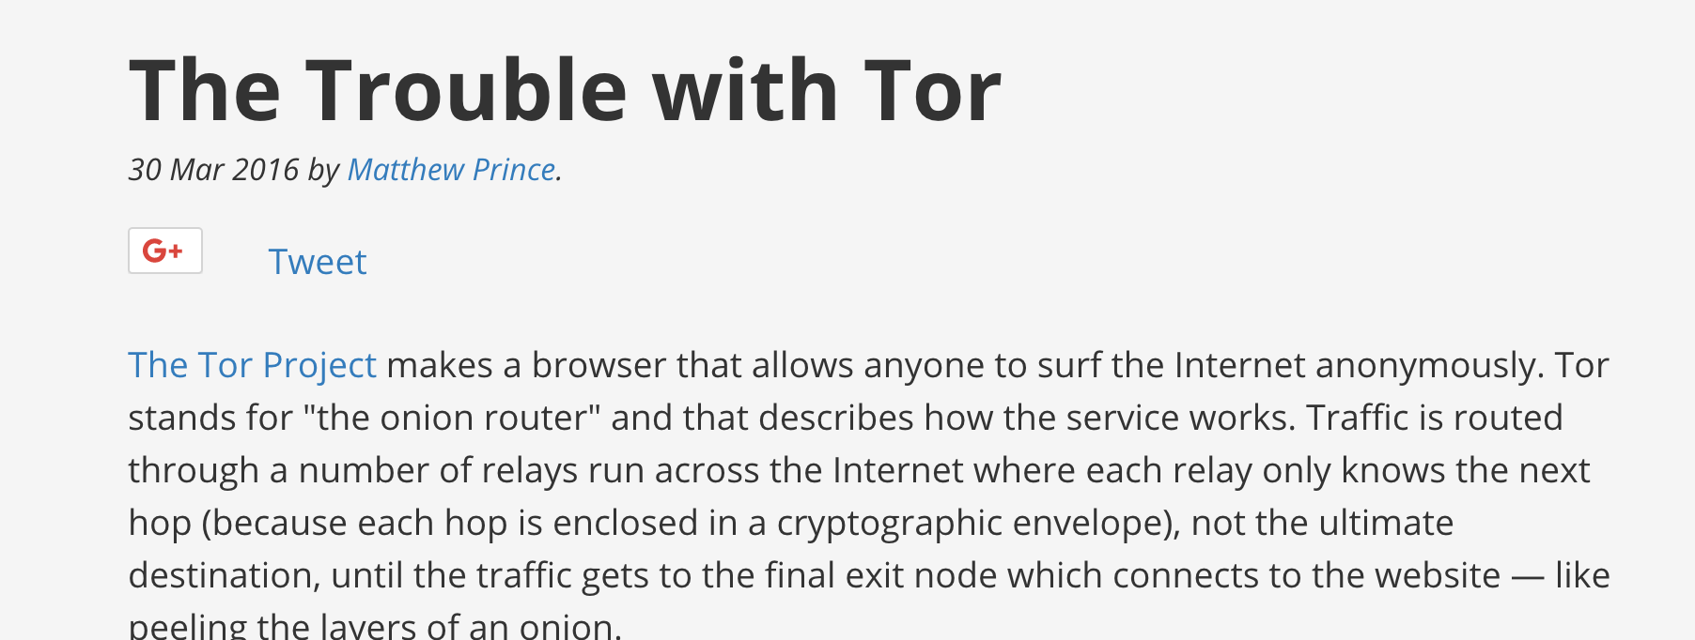
Centralization of Internet content platforms is exacerbating takedown risk.

Slide 17
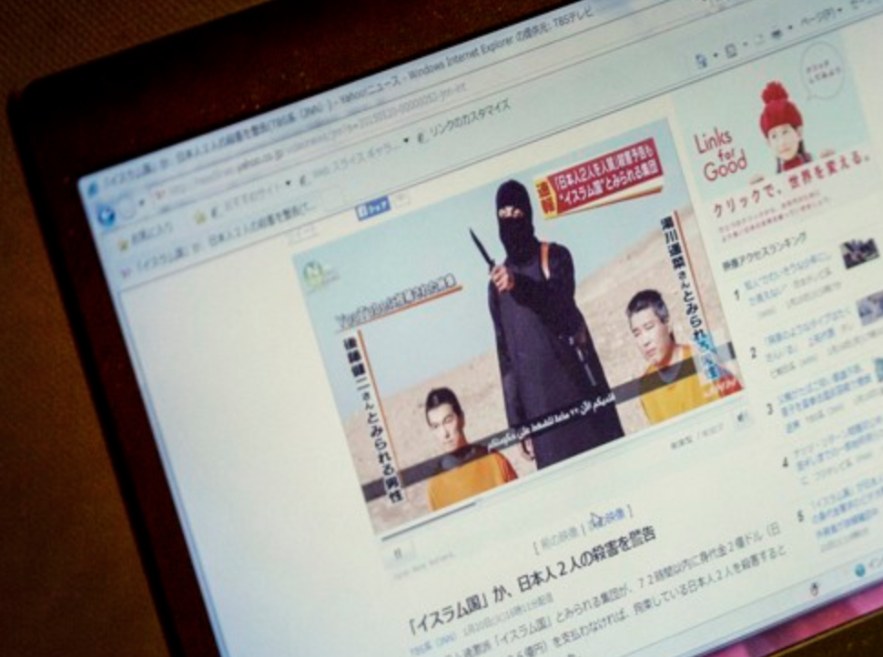
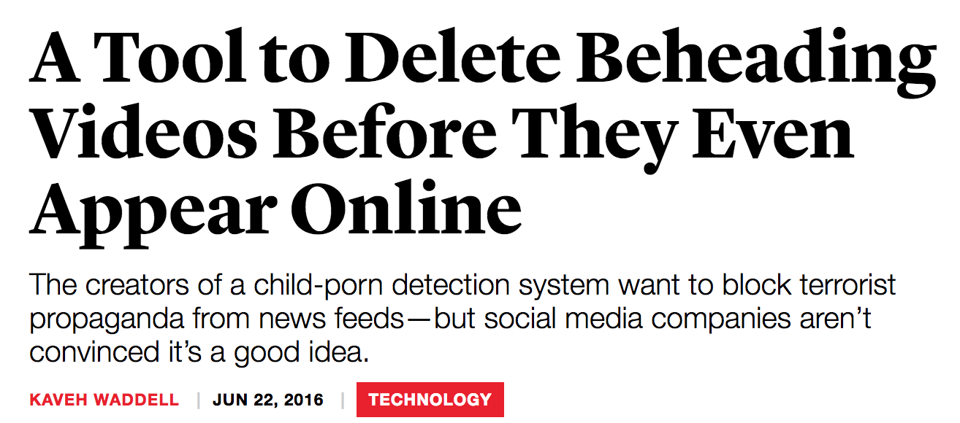
Filtering and Speech
Notes:
“oh wait… you can take down other stuff, too?”

Slide 18
General content moderation is harder than the “old” problems.
Offending content is infinite
Context is absent
Fair use?
Parody?
…

Slide 19

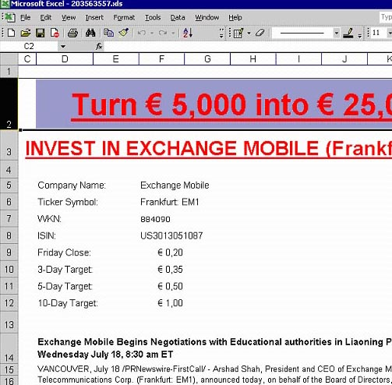

Content Analysis Doesn’t Work (2008)
PDFs
Excel Sheets
Images

Slide 20
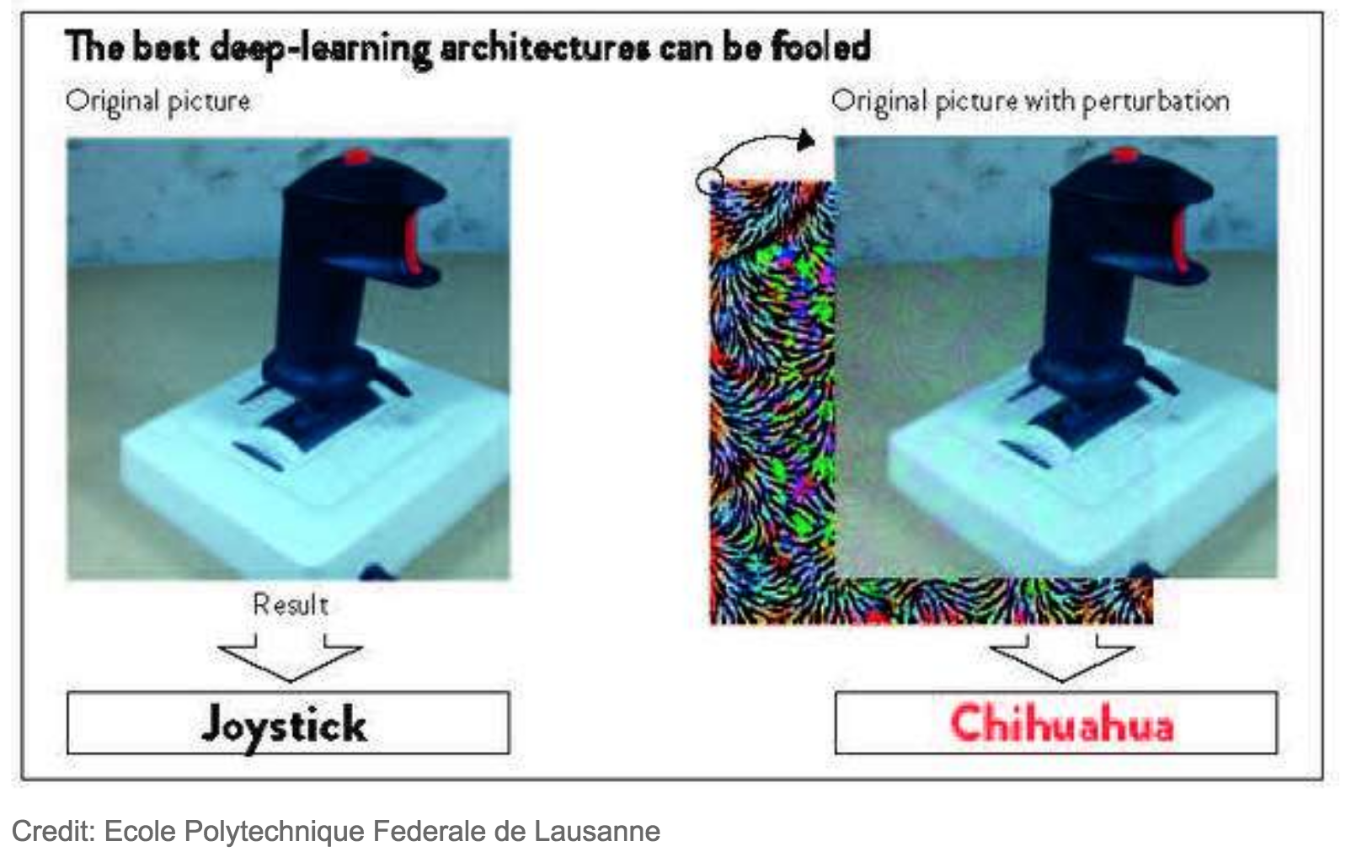
Content Analysis Still Doesn’t Work (2018)

Slide 21
Disinformation... (a.k.a. “Fake News”)

Slide 22
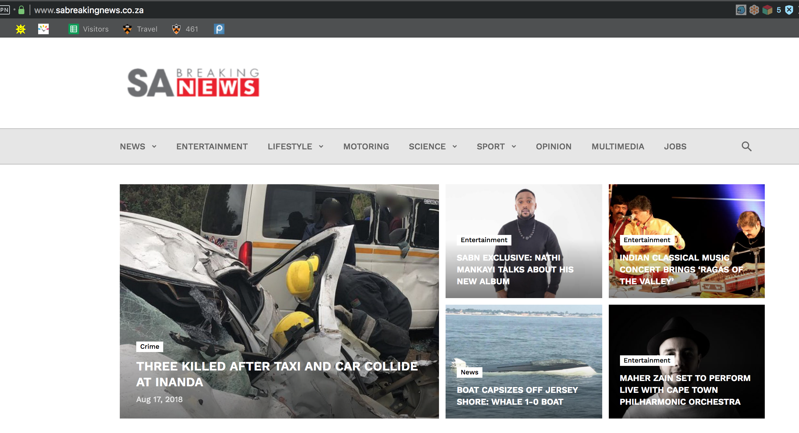

Slide 23


Slide 24
Instead of Content, What About Infrastructure?
Where is the website hosted?
Is it secure (i.e., HTTPS) or not?
What about the domain name (e.g., marketscreener.com)?
...

Slide 25
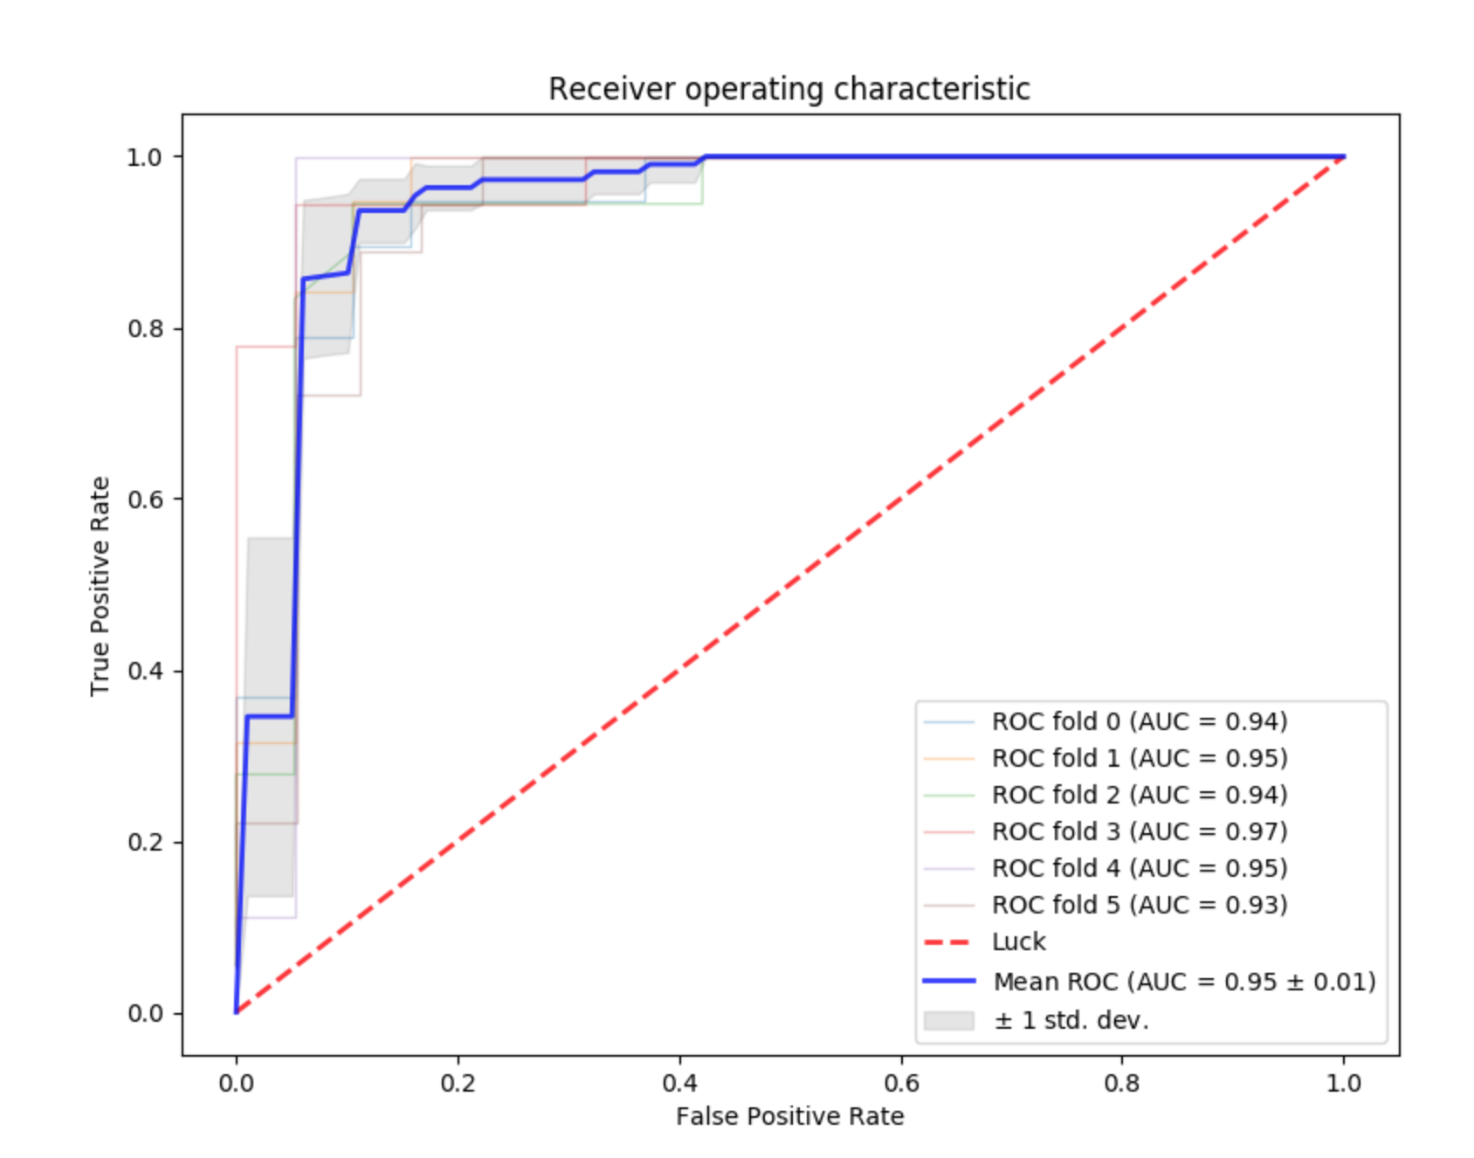
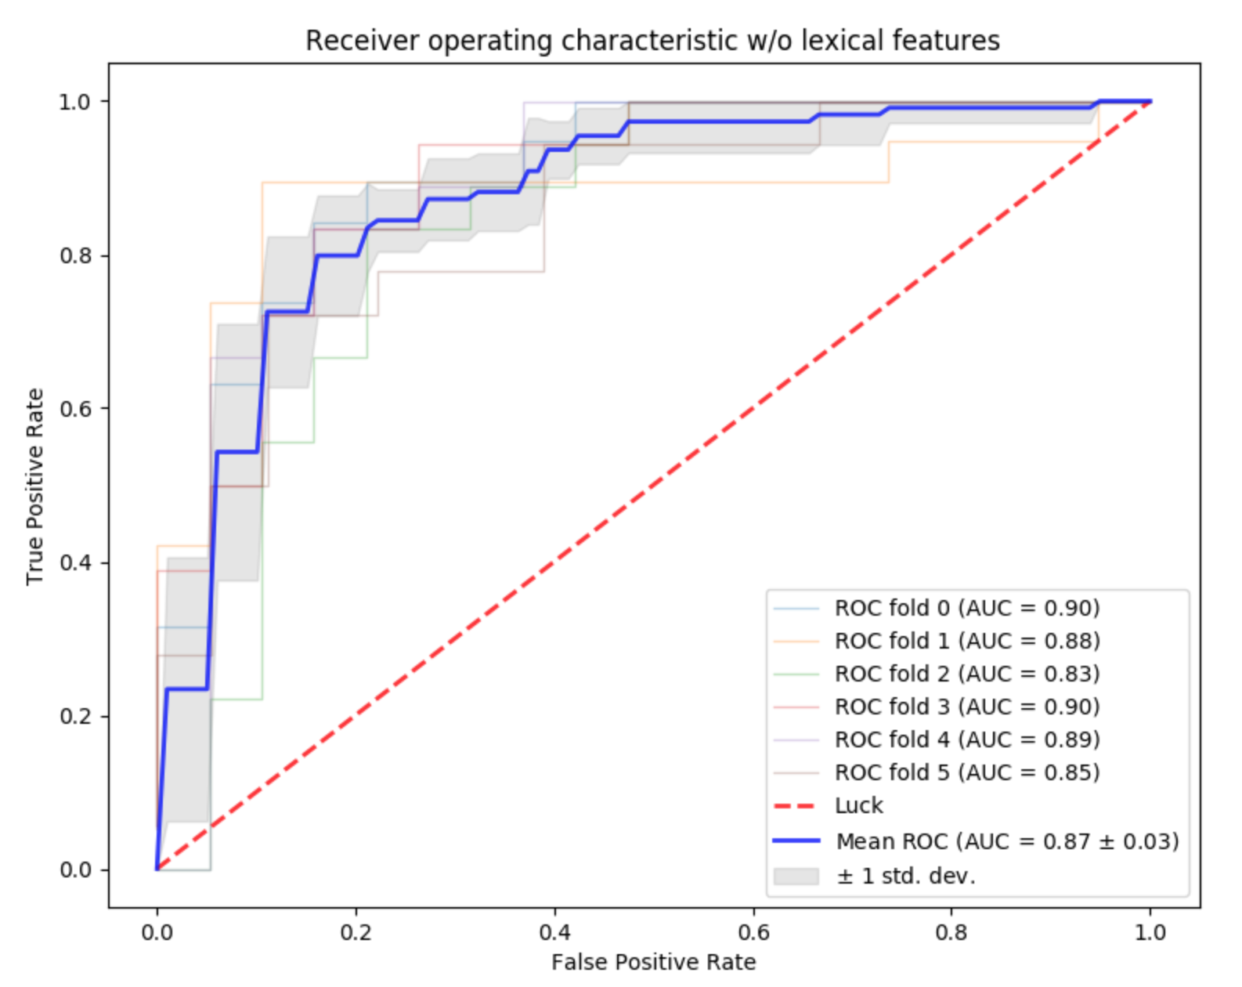
Early Results: Disinformation Websites Hosted in Funny Places

Slide 26
Conclusion
Control of online speech started with censorship and filtering
It is increasingly about controlling the conversation (disinformation, etc.)
The network infrastructure used to launch these new attacks on information looks bizarre
We can use this insight to detect “unwanted” content without having to rely on content analysis

